Slide 1
Gen AI For Engineering
SX/EDS-MM

Slide 2









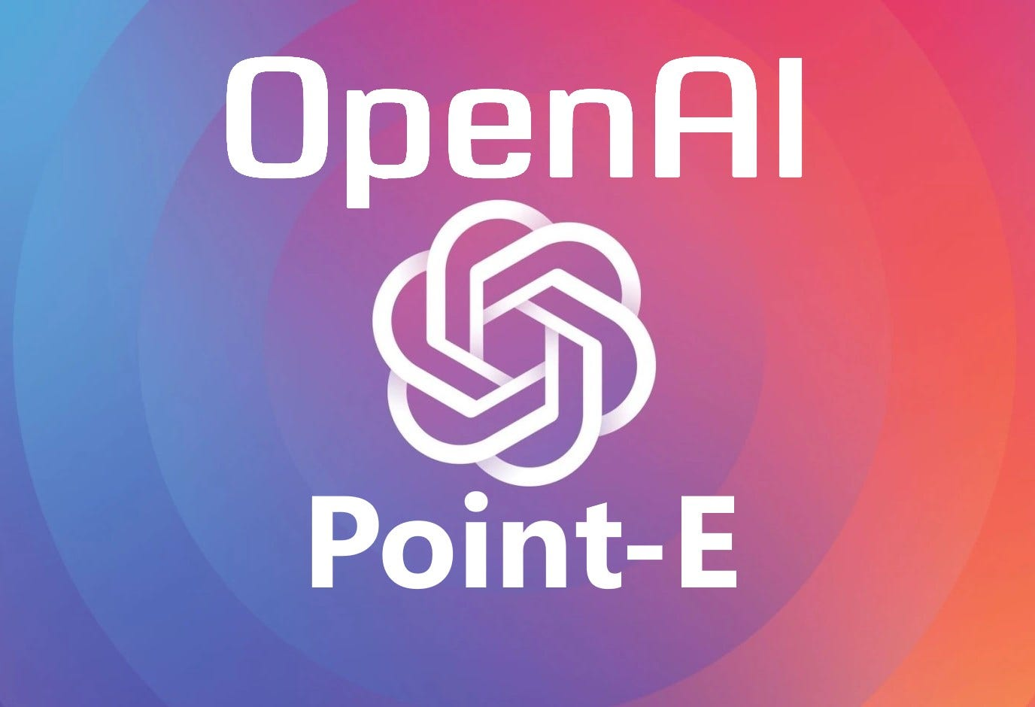




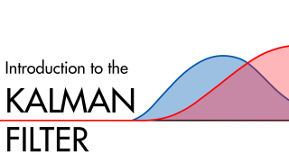

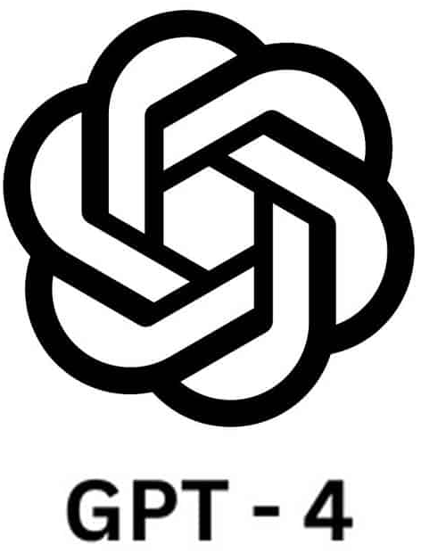


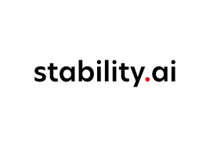
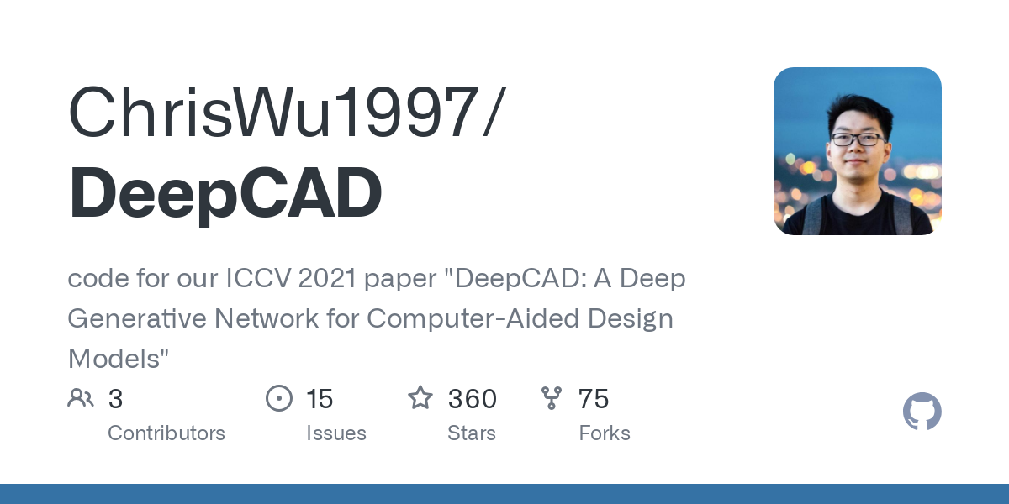



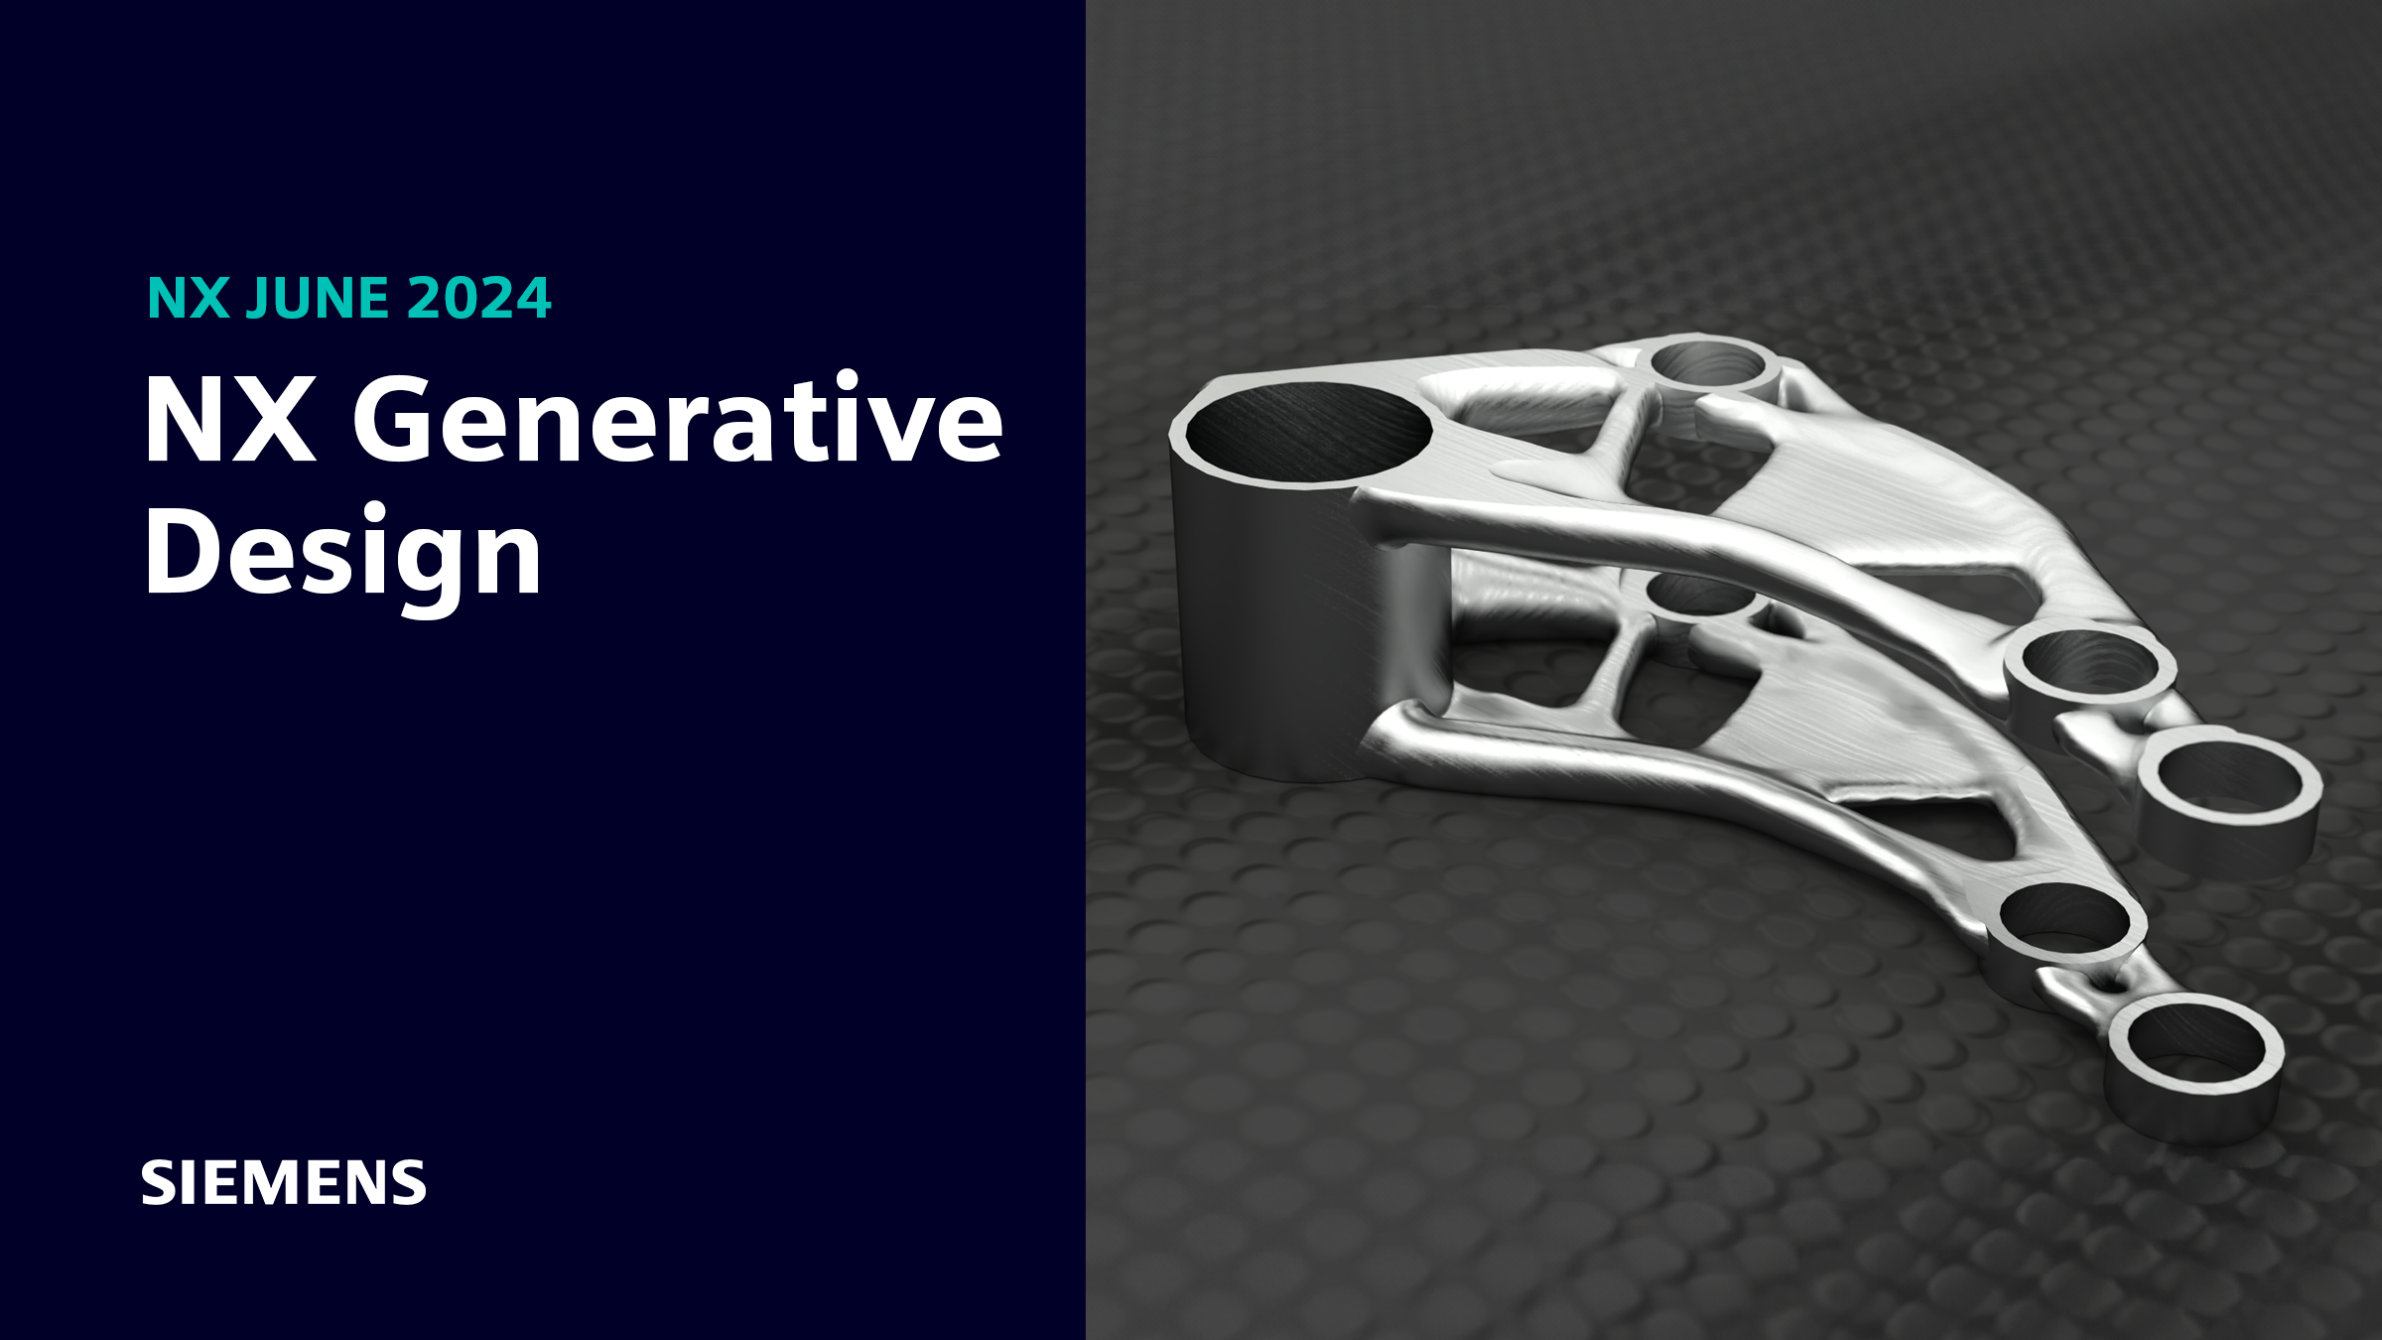
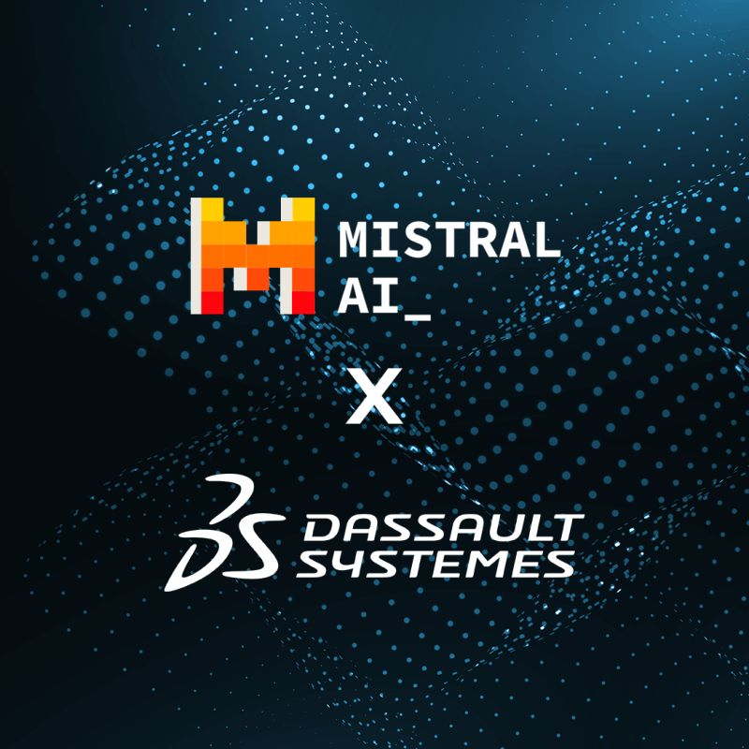
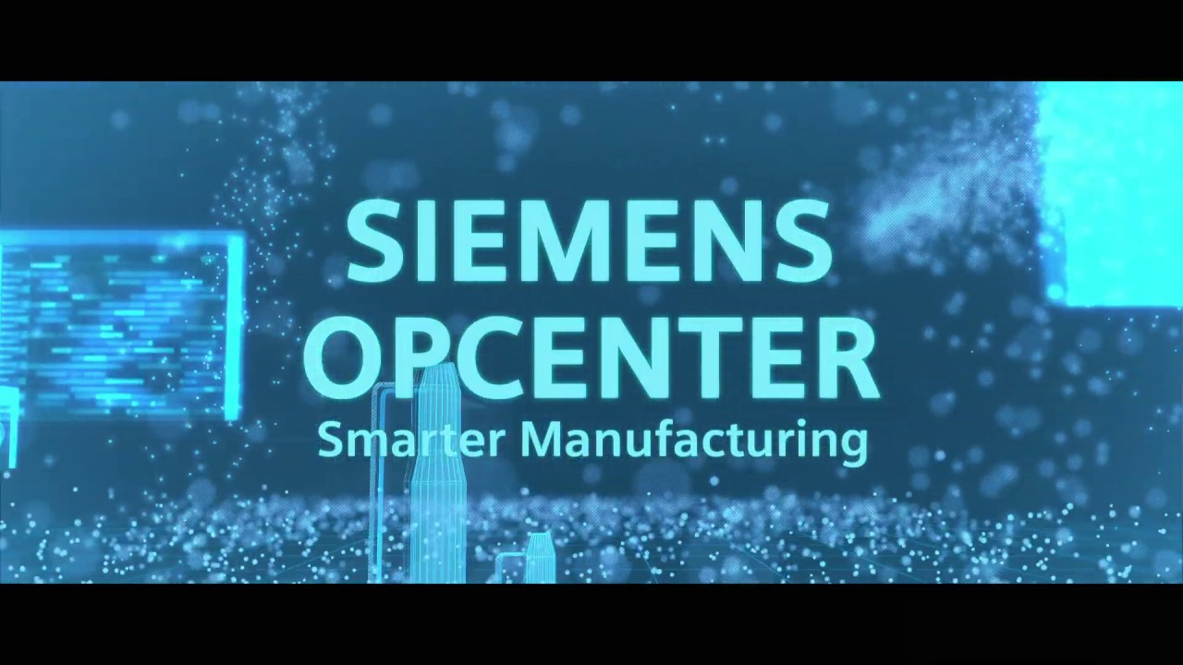
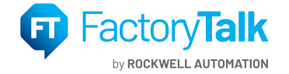
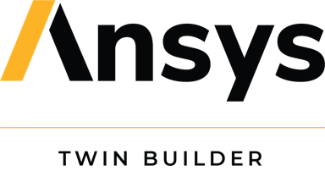




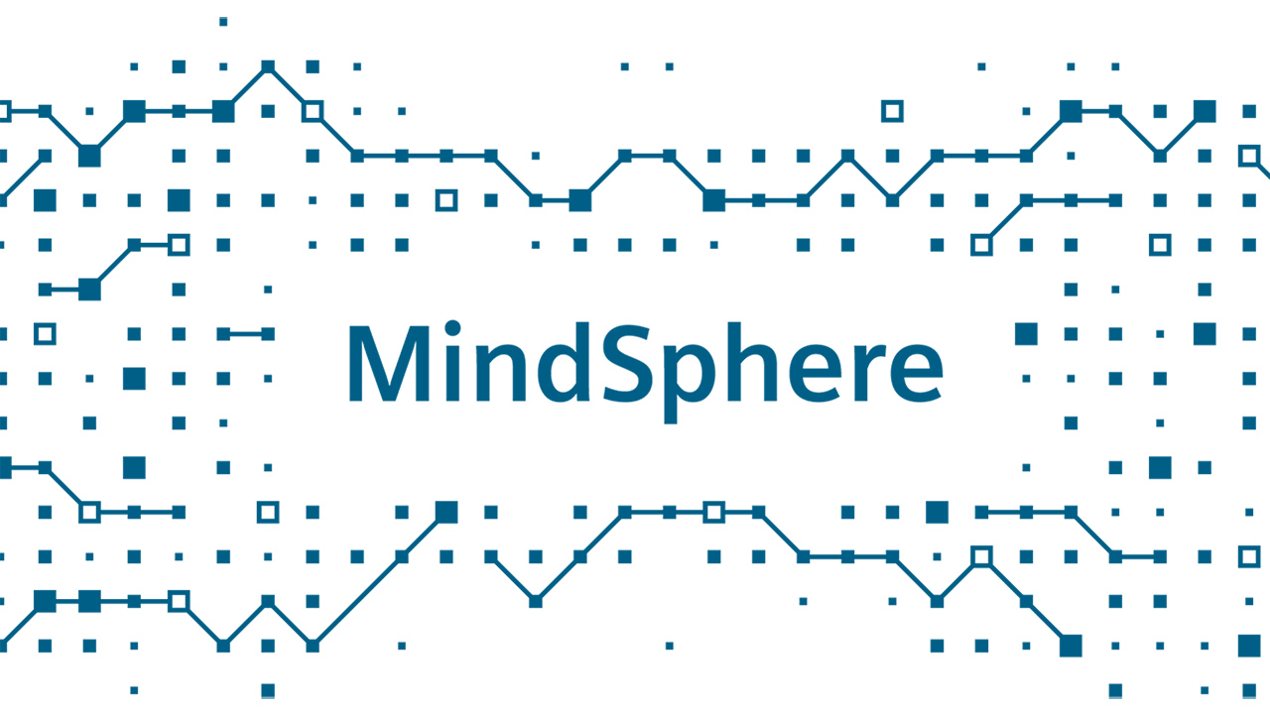


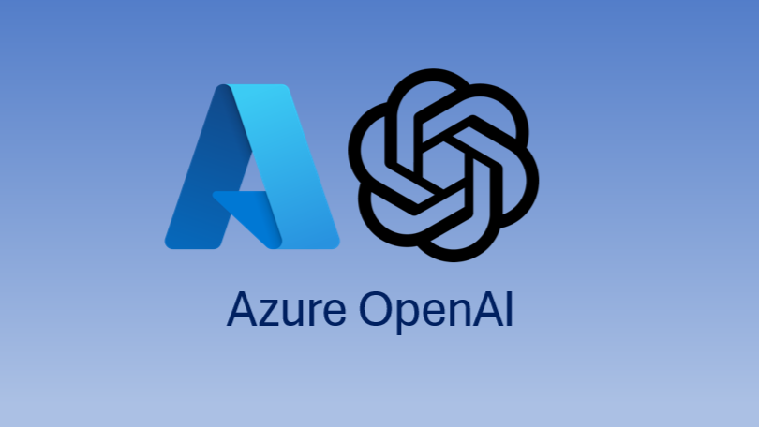
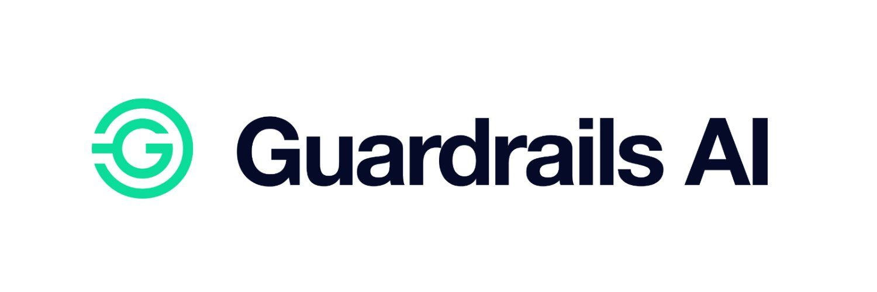

Gen AI Building Blocks for Engineering Workflows
Gen AI unlocks value at every stage of the engineering workflows
Engineering Datasets
Simulation & Synthetic Data
Domain-Specific Knowledge Base
Data Layer
Foundation for AI Models
CAD Designs
Schemas
Maintenance Logs
Synthetic Data
Crash Test Data
Sensors
Org Knowledge
Technical Docs
Regulatory Docs
Diffusion Models for 3D & CAD
AI for Code & Automation
Gen Design & Simulation Models
Sensor Fusion & Predictive Models
Language Models
(S,M,L)
Model Layer
Ground and Domain-Specific Models that handle Engineering Data
App Layer
AI-Driven Engineering Tools & Workflows
AI-Assisted CAD & PLM Systems
AI in Manufacturing Execution Systems
Digital Twin & Simulation Platforms
AI for Documentation & Chatbots
Deployment Layer
Deployment & Integration Layer
Edge
Cloud & API Services
AI Output Validation & Robustness
Notes:
End to end value creation in each layer
Count of success stories / effort saved etc. till date
Probable effort saving / ROI one could see
Assets, etc. that have been created
GenAI for Engineering for NE-MM
GenAI -> Total Revenue tracking
GenAI for Engineering -> projects / revenue (Software Engineering. Prod eng. )
3rd party components need not be shown
Instead in the process flow what is it we are doing / to offer
What is being presented in Mobility for GenAI for Engineering
Engineering life cycle what do we offer

Slide 3









Gen AI For Engineering – SX/MM Approach
DeepDive Workshop
45 Mins – 60 Mins
Initial Exploration
30 Mins
Build a Quick PoC
2 Weeks – 1 Month
Scale Solution
4. Showcase PoC
30 Mins
Align on:
Scope
Architecture
Roadmap
Resourcing
Use Case Owner
NE-MM Gen AI Expert
Project Manager
Hands-On Workflow
Gather Data & Docs
YES
Use Case Owner
SX/MM Gen AI Expert
Project Manager
PoC Scope Alignment
Architecture Design
Effort Estimation
Develop & Test
Use Case
Stakeholders
SX/MM Team
Q&A and
Feedback
PoC
Okay ?
NO
Re-evaluate Use Case

Slide 4
Case Studies

Slide 5

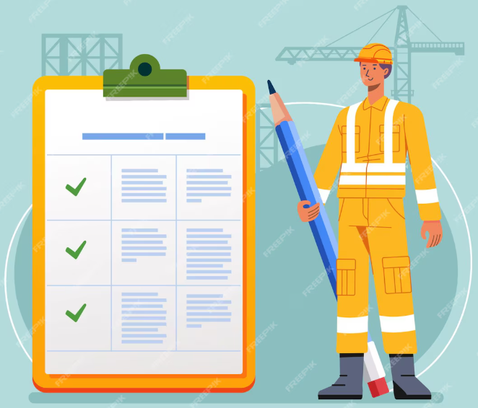



Requirement Similarity Evaluation
Engineering teams often struggle with incoming work requirements that are poorly defined, lack context, and contain significant duplication or overlap. This leads to poor planning and redoing of already done work.
Our Gen AI-driven solution analyzes the similarity between incoming requirements, assigning scores to quantify their overlap.
Intelligent filtering of
requirements before
starting development.
Elimination of
rework or duplicate work
Leveraging of Historical
Requirements in a
Knowledge Base

Slide 6
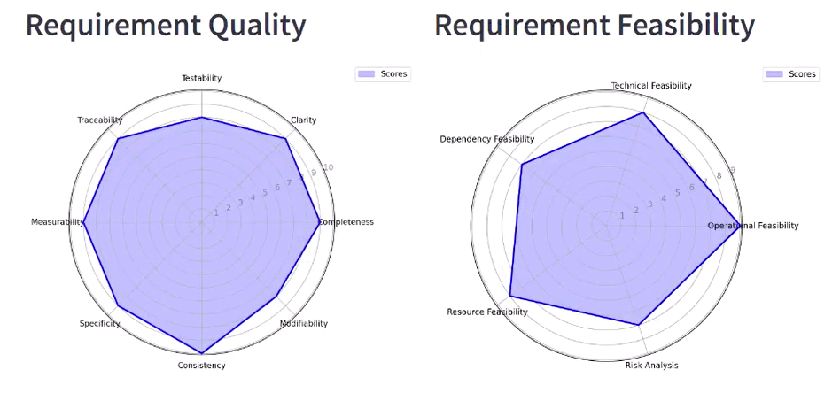


Requirement Quality and Feasibility Evaluation
As new requirements come in, often abstract and open to interpretation, teams need a reliable assistant that can quickly and effectively analyze the quality parameters of each requirement. Additionally, it should be capable of leveraging technical expertise to assess the feasibility of implementing these requirements, ensuring that teams can make informed decisions with greater confidence and efficiency.
Our Gen AI-driven solution applies the standard requirement quality check practices and historical project knowledge to derive the scores.
Reduction in Cognitive
Burden for Teams to
determine requirement
solutioning
Immediate flagging of low
quality, or incomplete
requirements with evidence

Slide 7

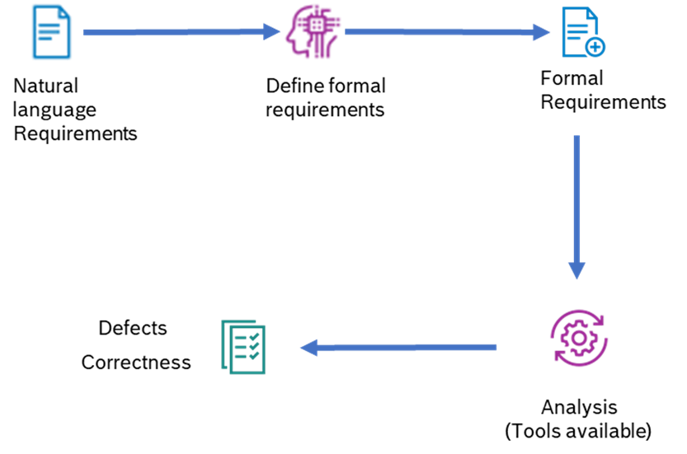
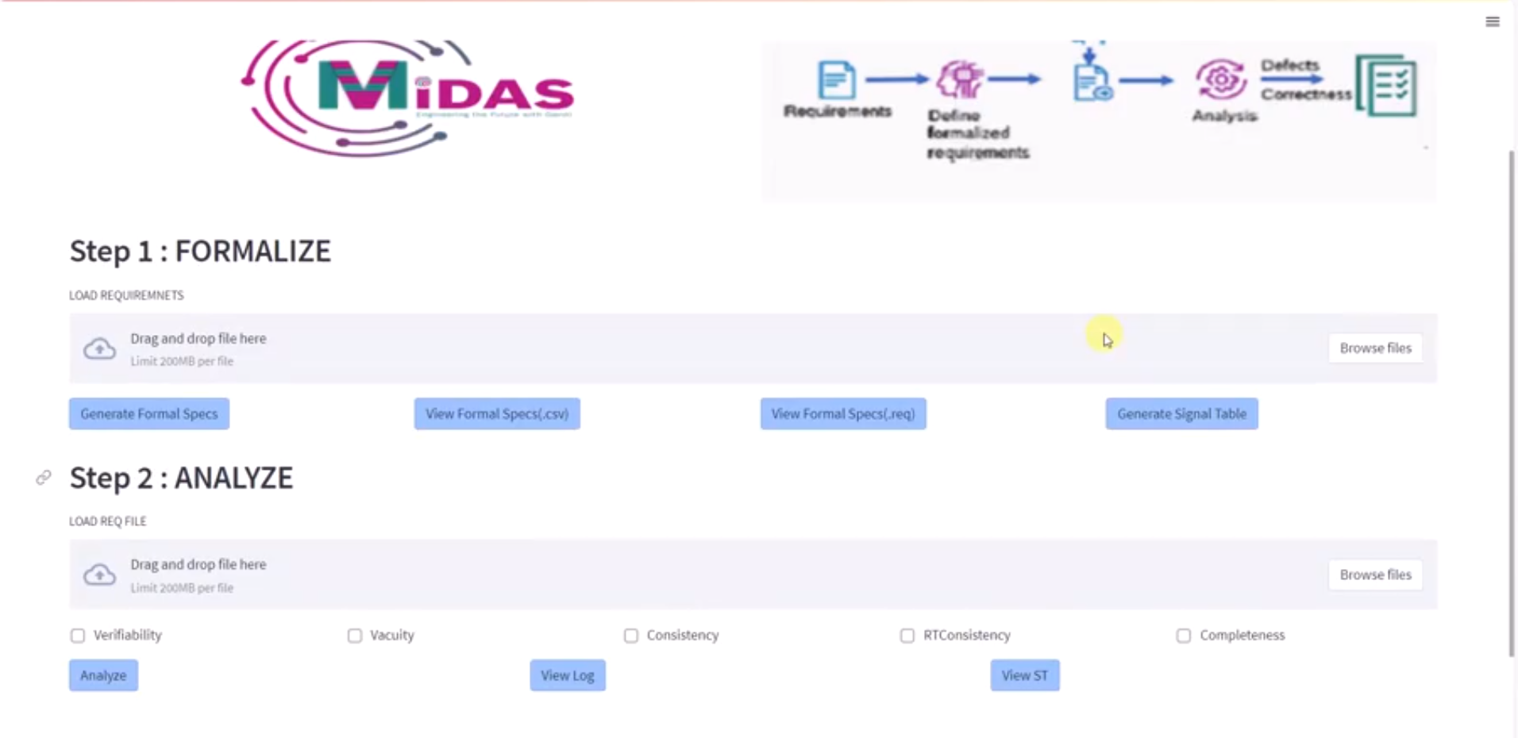
MIDAS: Requirement Quality Assist
Unclear requirements lead to misalignment, costly rework, and delays. Manual validation is slow, error-prone, and inefficient, increasing project risks. A structured, automated approach is needed to enhance clarity and efficiency.
RQA automates requirement quality assessment in the SDLC by converting natural language into formal specifications and providing the ability for automated analysis and feedback to improve clarity, consistency, and verifiability.

Slide 8

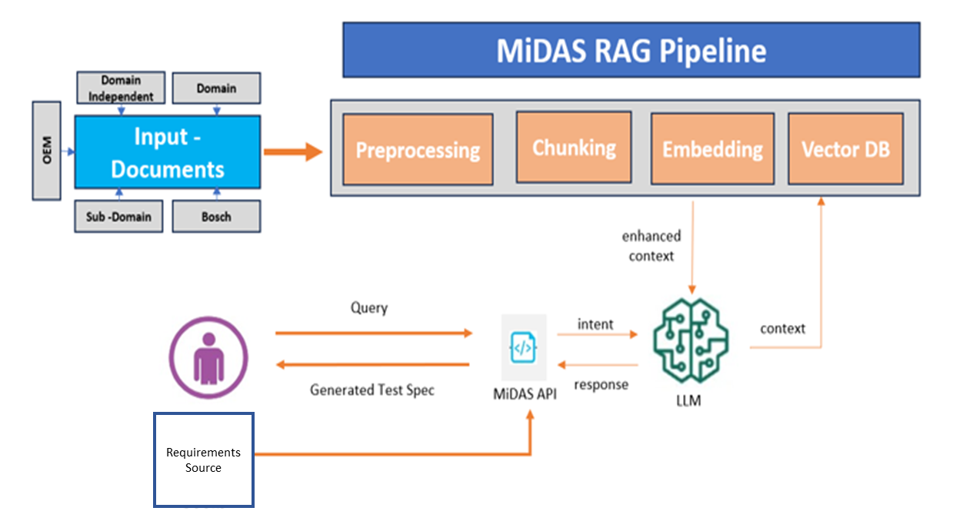
Autogen Agent: Test Specification Assistant
Test specifications are manually created, leading to inconsistencies, high effort, and dependency on individual testers. This process is time-consuming, difficult to scale, and challenging to maintain as requirements evolve.
TSA will automate test specification creation by analyzing requirements, ensuring alignment with templates, project guidelines, and contextual data. It will enhance consistency, reduce manual effort, and dynamically update test cases as requirements evolve.

Slide 9
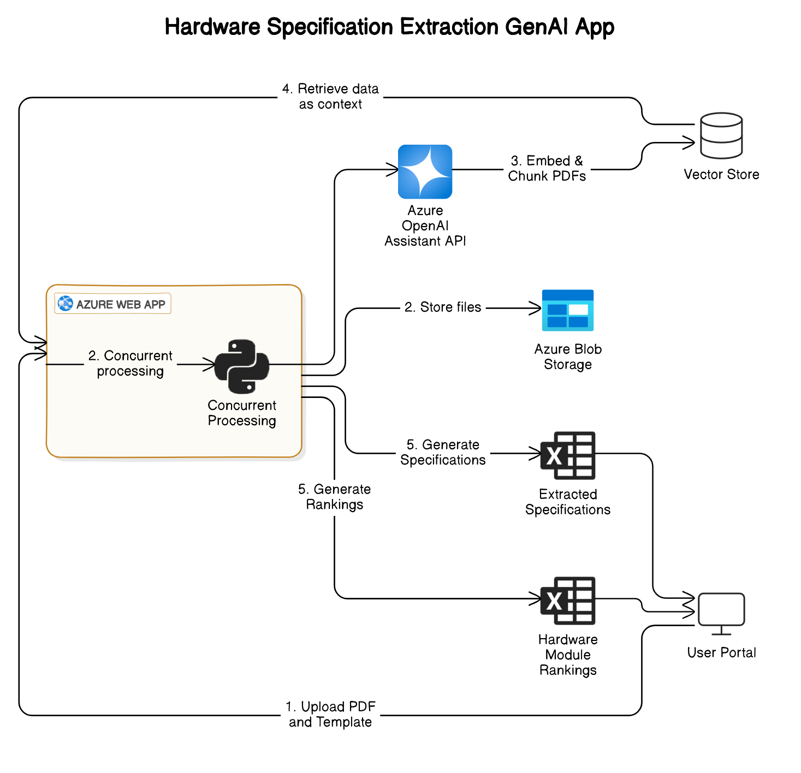





Hardware Component Evaluation with
GenAI
Client Need was looking for a solution to automate the extraction and comparison of hardware specifications tailored to user-defined criteria.
Developed a GenAI-powered solution that :-
Automates the extraction of hardware specifications from multiple documents, simplifying the comparison process.
Leverages the Azure OpenAI Assistants API to analyze, rank, and present components based on specific user requirements.
Significantly reduction in evaluation time
Improved accuracy in component selection
Enables users to quickly identify
the most suitable hardware for
their use case
Notes:
DAR Analysis

Slide 10
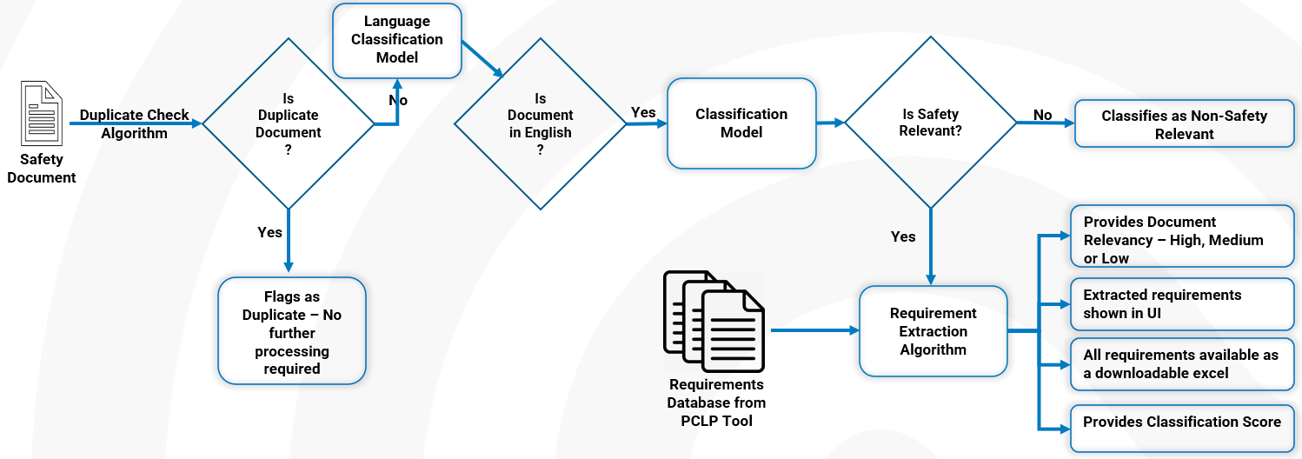






Procodex Functional Safety
The ProCodex safety team manually analyzes automotive regulatory documents, classifying them for safety relevance and extracting safety requirements. Tracking similar requirements with minor differences is challenging.
Our AI solution, powered by NLP, automates document classification, semantic matching, and requirement extraction in the PCLP tool. It also groups similar requirements by ID, with a keyword search feature for verification.
Lead time significantly
reduced with our
AI solution.
Document processing (≈100 pages)
cut from 30 hours (3–4 days)
to <2 hours.

Slide 11
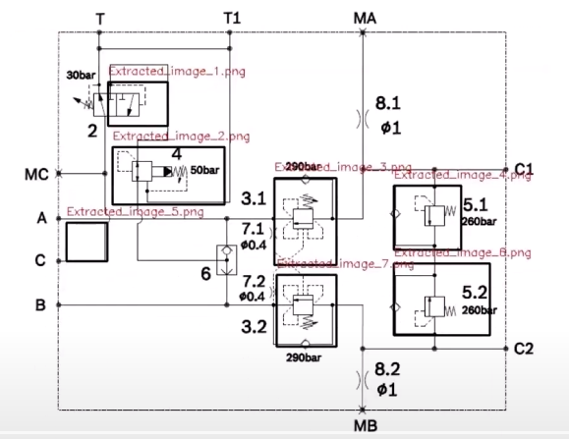
Schematic Diagram Detection and Product recommendation system
The tool aims at extracting schematic designs (e.g. hydraulic pumps) from a customer given image data and provide mapping about the correct valve codes as seen in the master PDF documents
Our AI solution, powered by SegGPT – a Transformer model for Semantic segmentation, automates image understanding , capturing correct pump designs from image and maps the designs to the master PDF information.
The major impact of this tool are:
Increasing efficiency in extracting information from a customer provided schema by getting recommendations from tool
Reducing human error in identifying the right schemas in master PDF.

Slide 12
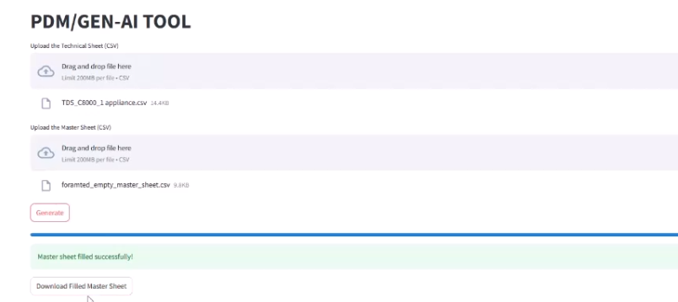
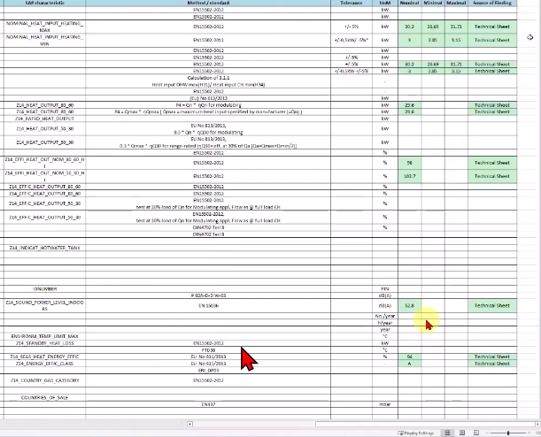
Product Data Mapping using Gen AI
Users struggled to extract appliance specs from dense technical sheets, making mapping inefficient. The client needed a filled master sheet, generated by fetching data from these sheets.
With Gen AI, Excel sheets were converted to CSV for efficient processing, and AI reasoned over sheet structures to create LLM instructions. Once trained on past examples, it auto-mapped new technical sheets to the master sheet, ensuring speed, accuracy, and minimal manual effort.

Slide 13







AI First Engineering – Break the Patterns to Reimagine
Changes Needed
Conversational, Expert Sparring Partner
Breaking Patterns
Re-hash Roles / Re-skill Associates
AI First Engineering
Common Standards (Data, Processes, Industry)
Assisted Engineering
Human in Loop
Re-define Engineering Processes
Unlock Business Potential - Shorter Time-to-Market

Slide 14
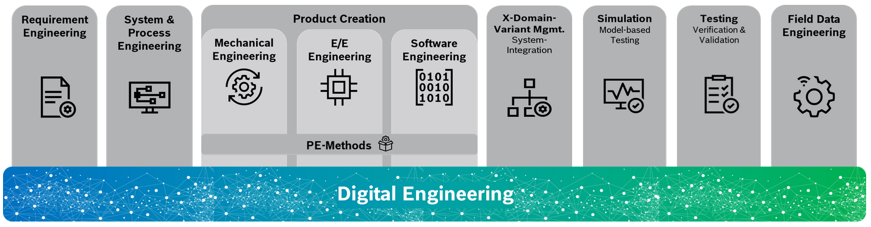
Keynote
Title
Leveraging GenAI in Engineering
Target Audience
Engineering Heads from software hardware and mechanical engineering, NEs, PRMs, BDO
Intent
Our intent is to nudge the audience regarding faster adoption of GenAI to stay ahead.
Perceived expectation from Audience
Audience may be curious to know
GenAI adaption in other GBs in BOSCH
Use cases from other GBs
How GenAI can be used in HC engineering processes
What we would like to convey to the audience
Overall GenAI initiative at BGSW
Active collaboration between HC and BGSW - driving GenAI in Engineering initiatives
Notes:
Title : Leveraging GenAI in Engineering

Slide 15
Notes:
Show Partners like BD for infrastructure
For each column what products and solutions we can offer (RQA, RCA, Procodex)
Where we are currently
Some colour code on where we are
What are in POC, evaluation
Concept -> MVP -> Pilot -> Scale
Enable platform to realize engineering case studies (no MiDAS, but tell generically)
Which NE-MM GB has what focus -> Don’t have to show this as this is approach. But if we are doing some thing like for RAISE then can be our portfolio
Manufacturing is not in here

Slide 16
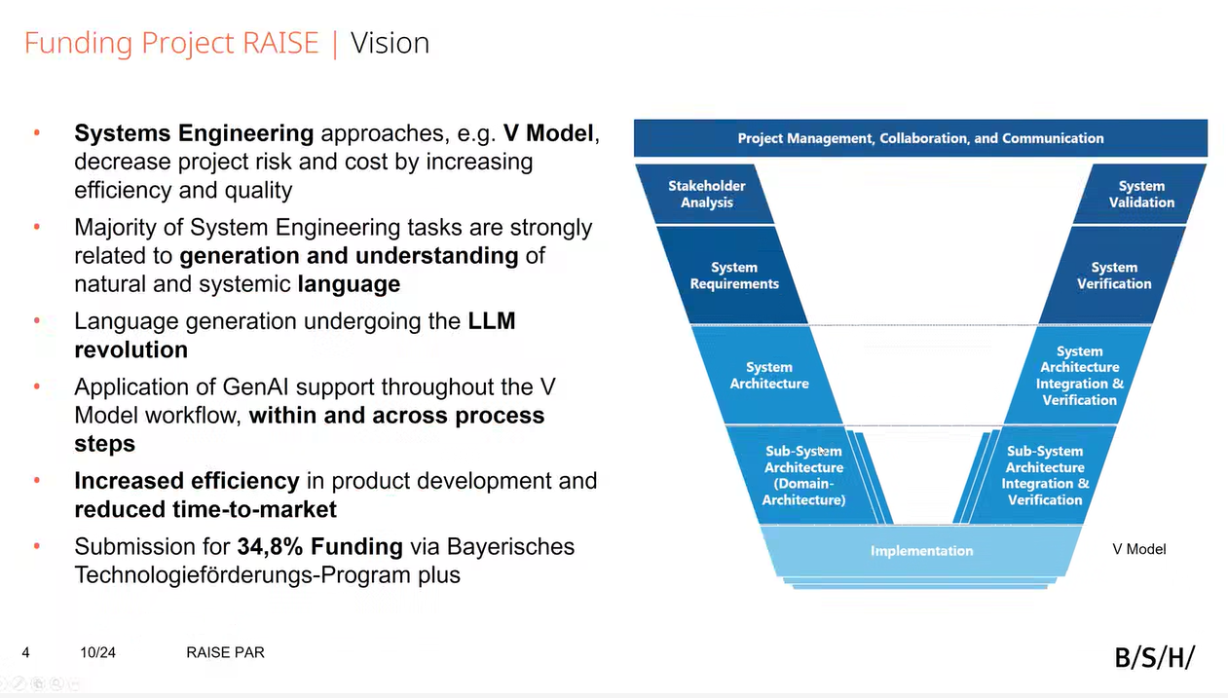
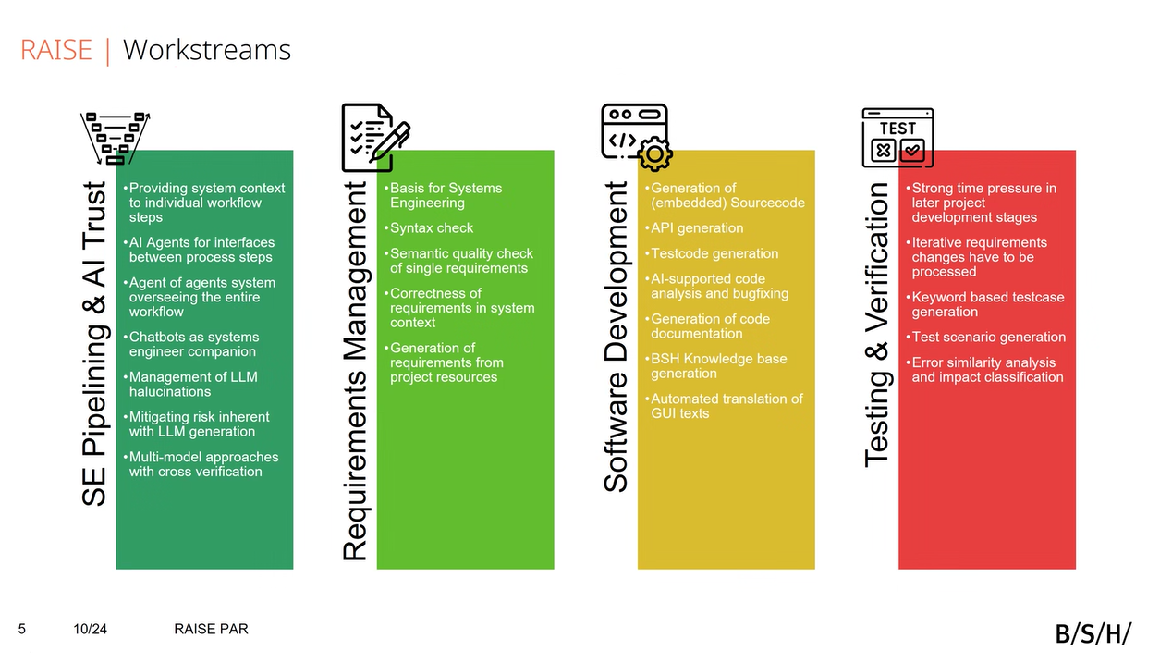
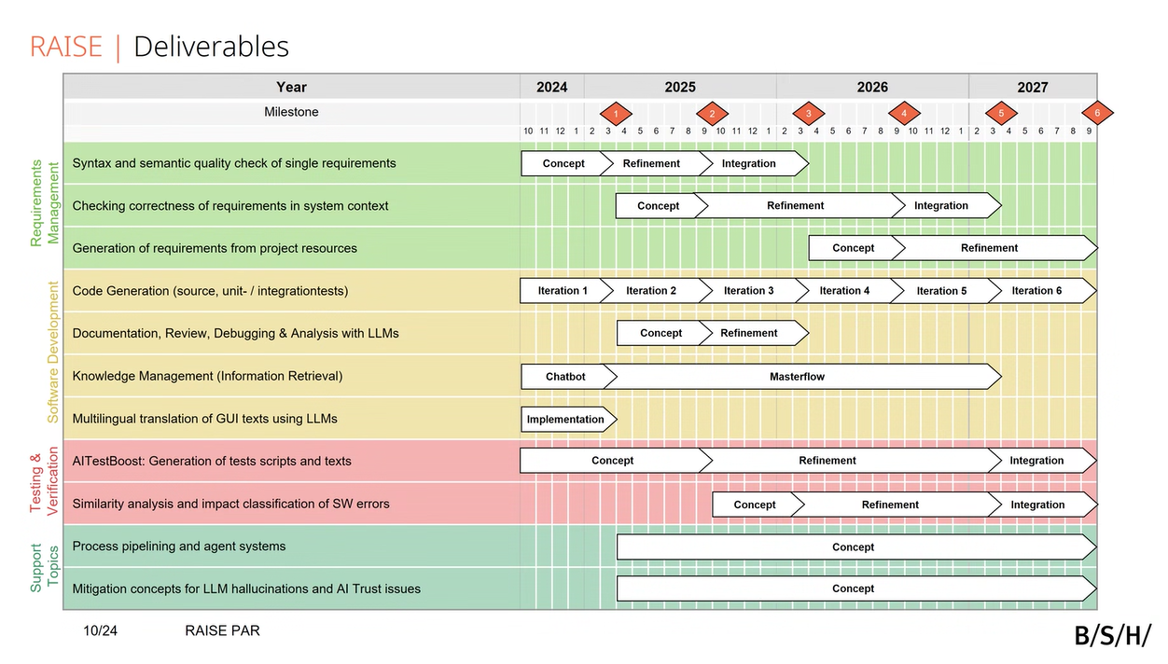
Notes:
Manufacturing is not in here

Slide 17
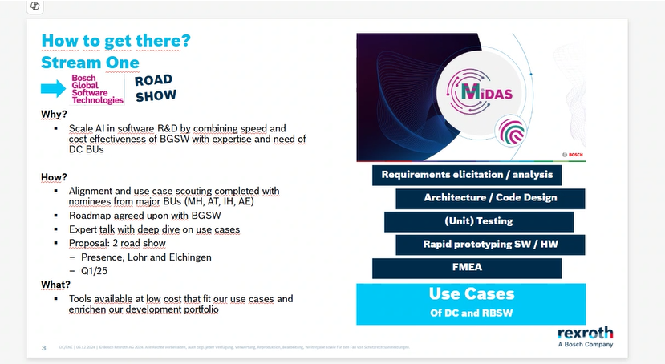
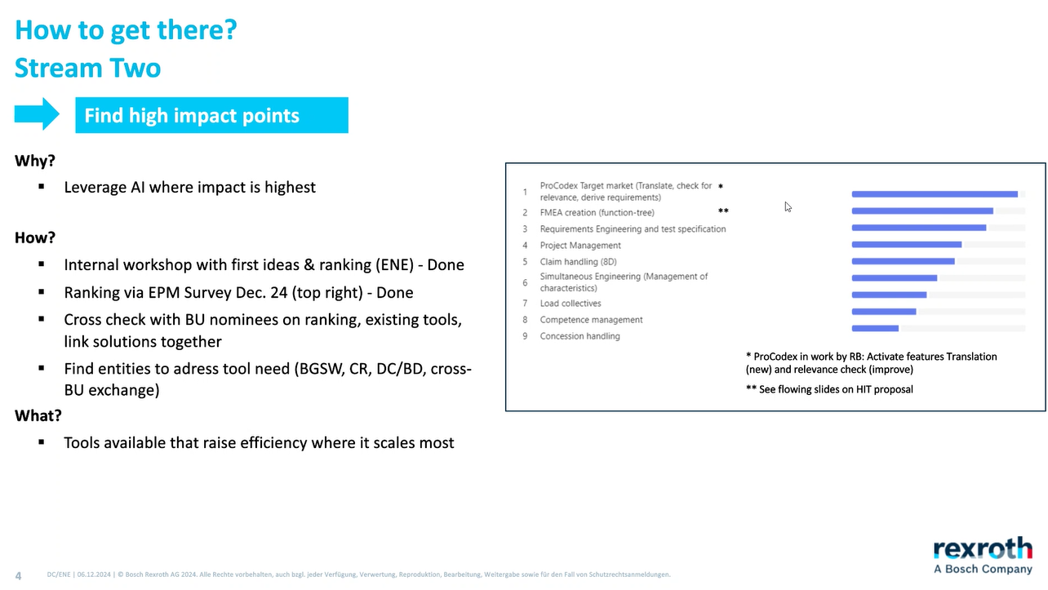
Notes:
Manufacturing is not in here

Slide 18
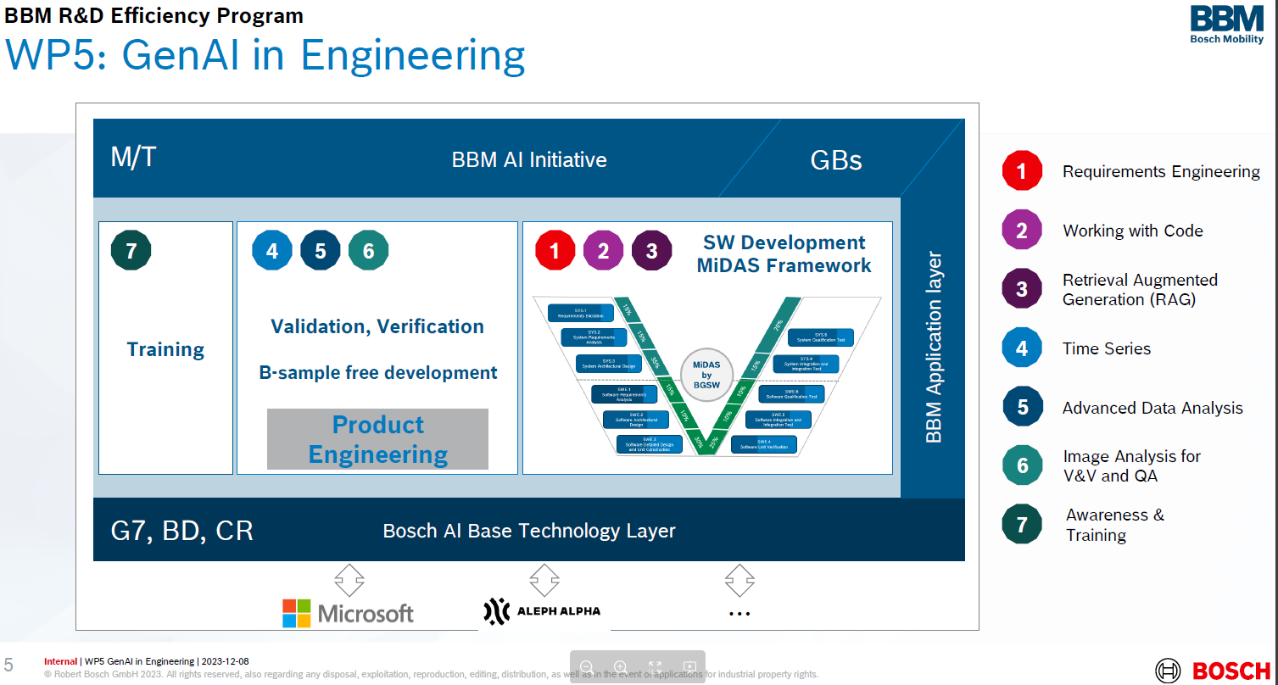
Notes:
Manufacturing is not in here

Slide 19
Notes:
Manufacturing is not in here

Slide 20
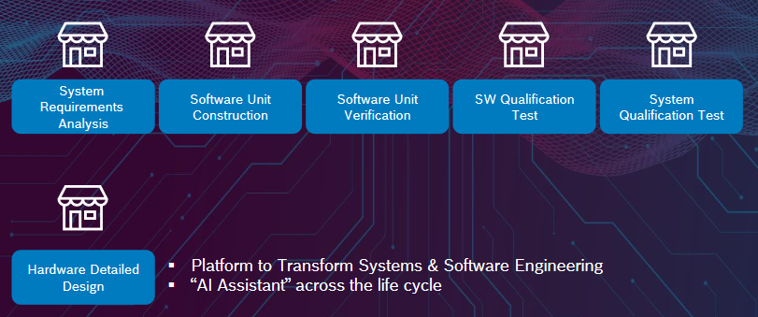
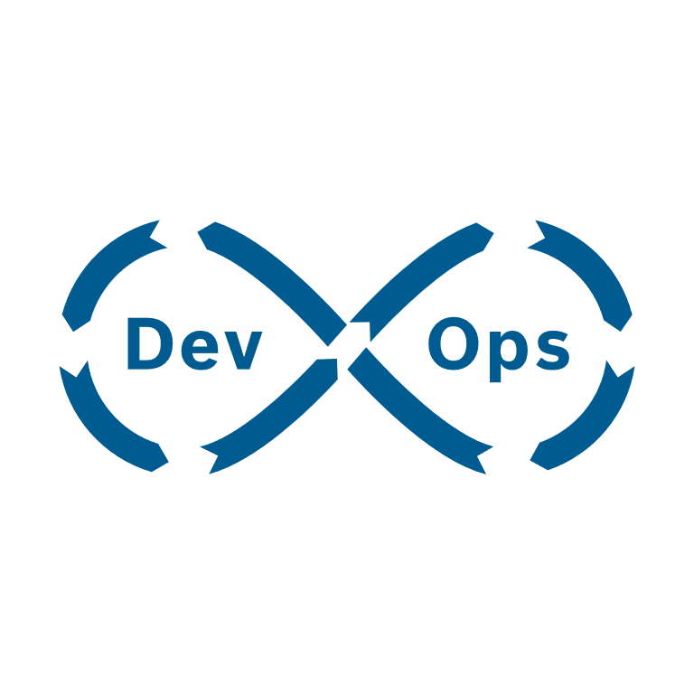
The Paradigm Shift – AI disrupts Engineering Lifecycle​
Bosch Engineering Model
SYS.1
Requirements Elicitation
SYS.2
System Requirements Analysis
SYS.5
System Qualification Test
SYS.3
System Architectural Design
SYS.4
System Integration and Integration Test
SWE.1
Software Requirements Analysis
SWE.6
Software Qualification Test
SWE.2
Software Architectural Design
SWE.5
Software Integration and Integration Test
SWE.3
Software Detailed Design and Unit Construction
SWE.4
Software Unit Verification
Gen AI Stack
App Layer
Platform to Transform Systems, Software & Product Engineering​
Use Cases
Orchestration
“AI Assistant” across the life cycle​
Context
LLMs
Adaptable for Domain Specificity
Notes:
Future of systems and software engineering will see a paradigm shift, with “Generative AI enabling our experts to break the patterns” by effectively bringing our systems, domain and engineering models together
MiDAS is a platform envisioned to accelerate innovations cycles by transforming R&D in Bosch
MiDAS will be integrating into Bosch ecosystem as an expert sparring partner and an able assistant across the engineering life cycle as a “Pair Requirements Engineer”, “Pair Designer”, “Pair Programmer” and a “Pair Tester”
As a platform, MiDAS will be adaptable to different domains and businesses across Bosch
Disruptive technology adaption requires, iterative approach and agility to pivot and adapt as the technology landscape is evolving rapidly. Since the program started in Jan ’24. MiDAS has harvested 78 use cases out of which 6 are in the piloting phase with 32 in the concept pipeline.
While it is important to stay ahead of technology trends, business impact should drive the technology adaption, MiDAS aims to bring 200 mEUR productivity in BBM R$D in next 3 years.

Slide 21
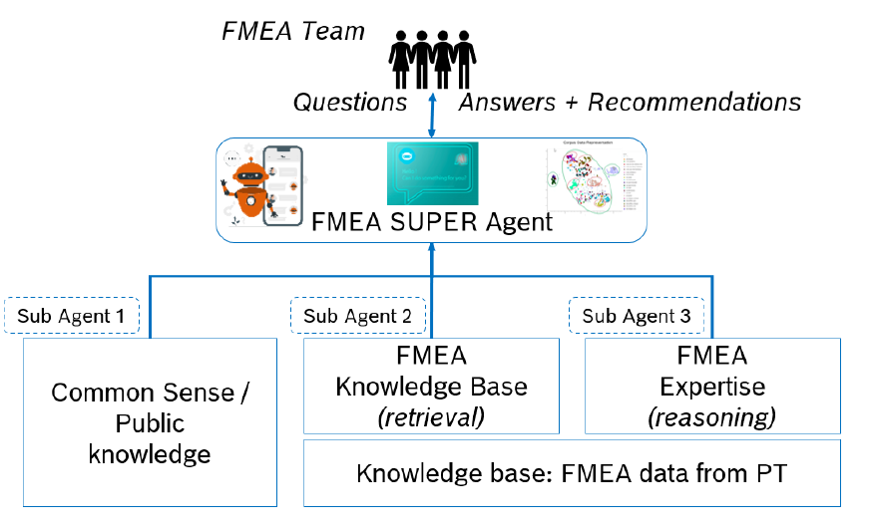
Notes:
Future of systems and software engineering will see a paradigm shift, with “Generative AI enabling our experts to break the patterns” by effectively bringing our systems, domain and engineering models together
MiDAS is a platform envisioned to accelerate innovations cycles by transforming R&D in Bosch
MiDAS will be integrating into Bosch ecosystem as an expert sparring partner and an able assistant across the engineering life cycle as a “Pair Requirements Engineer”, “Pair Designer”, “Pair Programmer” and a “Pair Tester”
As a platform, MiDAS will be adaptable to different domains and businesses across Bosch
Disruptive technology adaption requires, iterative approach and agility to pivot and adapt as the technology landscape is evolving rapidly. Since the program started in Jan ’24. MiDAS has harvested 78 use cases out of which 6 are in the piloting phase with 32 in the concept pipeline.
While it is important to stay ahead of technology trends, business impact should drive the technology adaption, MiDAS aims to bring 200 mEUR productivity in BBM R$D in next 3 years.

Slide 22
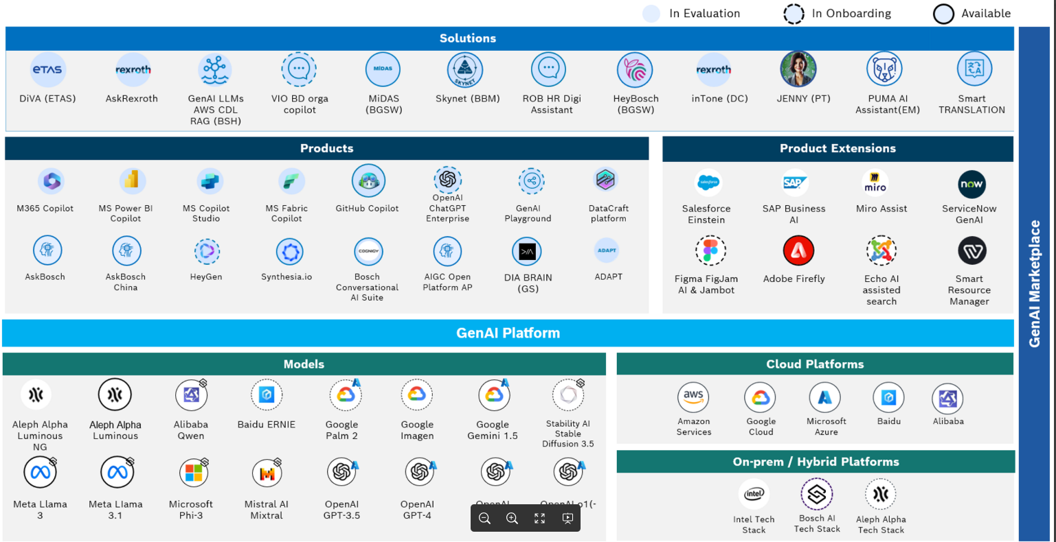
Notes:
GenAI Portfolio - Generative AI - Docupedia II

Slide 23
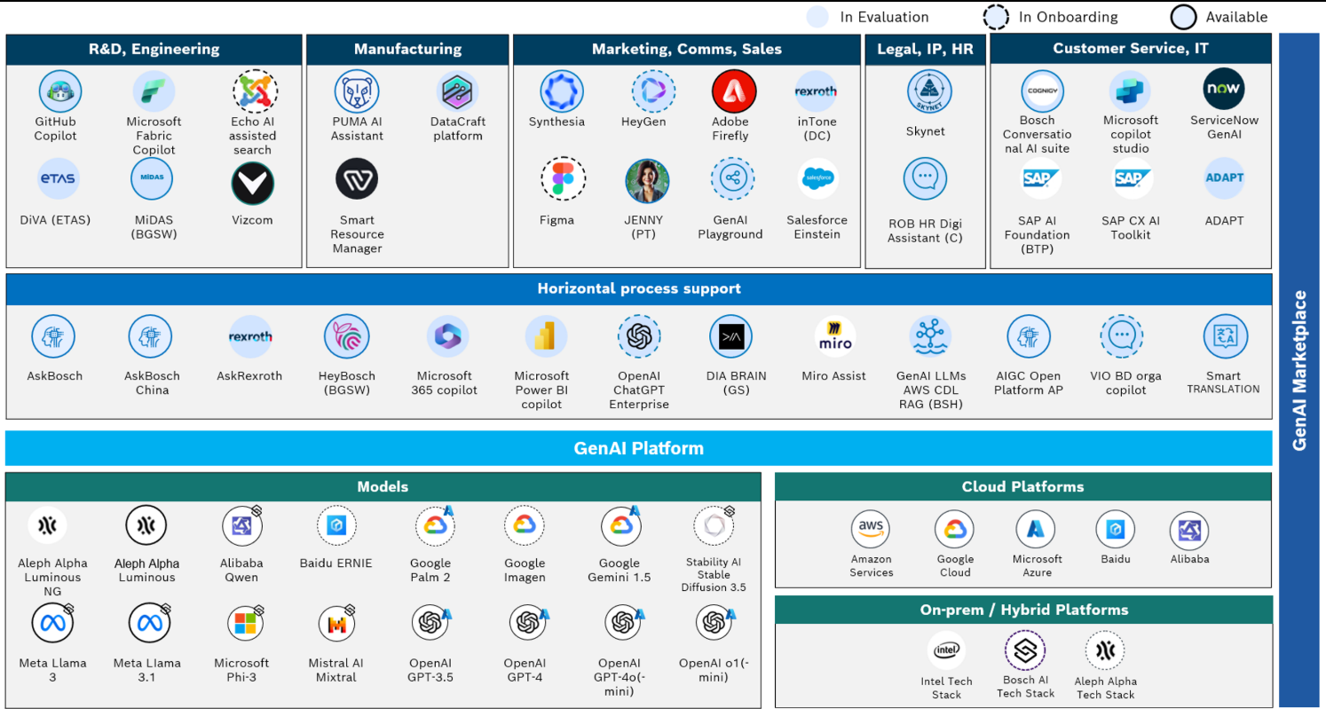
Notes:
GenAI Portfolio - Generative AI - Docupedia II

